Slide 1


Cypress for end-to-end testing
@AlainChautard - angulartraining.com

Slide 2


About me - Alain Chautard (or just Al)
Google Developer Expert in Web technologies / Angular / Google Maps
Cypress Ambassador Angular JS addict since 2011 Web consultant / trainer @ angulartraining.com Conference speaker all around the world

Slide 3
Useful links
Set-up instructions: http://bit.ly/at-cypress-setup
Link to my slides: http://bit.ly/ac-cypress
Repository with code examples: https://github.com/alcfeoh/ng-store-cypress

Slide 4
What is Cypress?

Slide 5
What is Cypress?
A complete end-to-end testing experience for anything that runs in a browser
Tests are written with Cypress
Tests are run with Cypress
Tests can be debugged with Cypress
Tests failures are recorded by Cypress

Slide 6
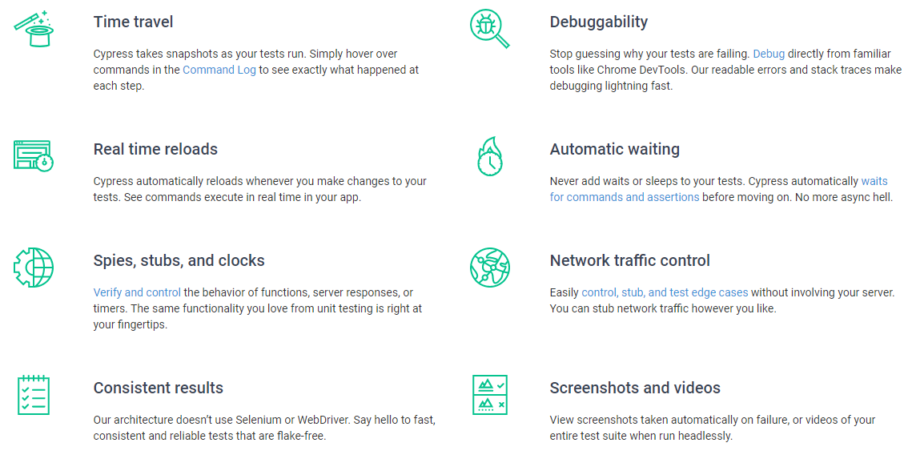
What is Cypress?

Slide 7
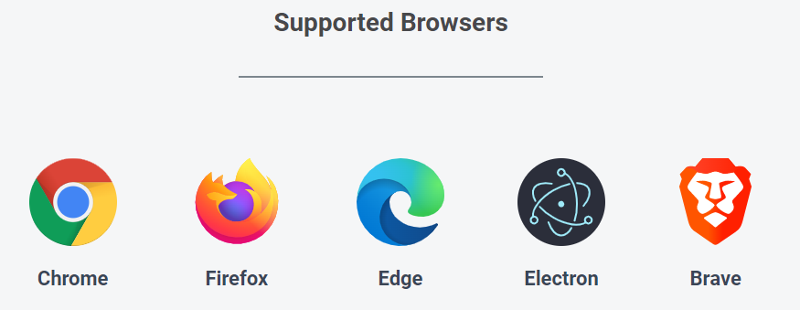
Cypress can run your tests with:

Slide 8
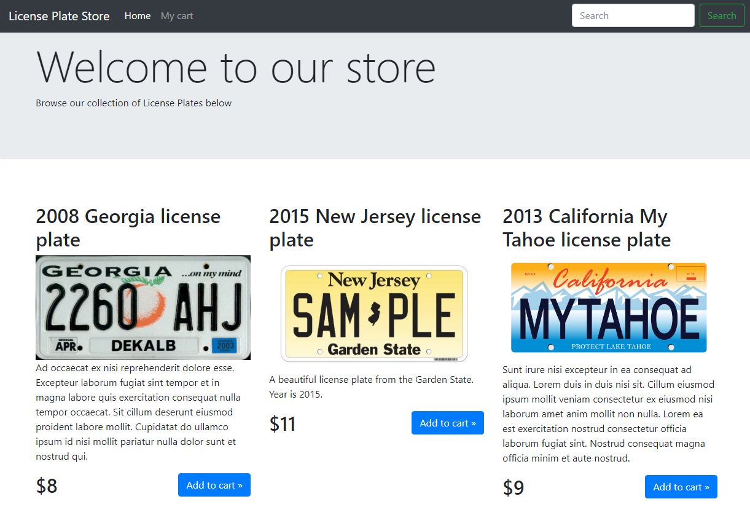
We are going to test a web app: http://store.angulartraining.com

Slide 9
Let’s write a basic test with Cypress
Cypress is based on Mocha and Chai, two popular JS libraries for testing
// A “describe” function is a suite of tests
describe('License plate store home page', () => {
// A “it” function is an individual test
it('displays the right main title', () => {
// Let’s visit the app - actual test goes here
cy.visit('http://store.angulartraining.com');
});
});

Slide 10
DEMO #1: First test run
npx cypress open

Slide 11
Cypress: contains
Contains selects an element by its text contents
Cypress will wait to find that element till a timeout is reached (4 secs by default)
The test fails if such element can’t be found after that timeout
it('displays the right main title', () => {
cy.visit('http://store.angulartraining.com');
cy.contains('Welcome to our store');
});

Slide 12
Cypress: Assertions
We can define assertions (and chain those assertions) on every single selected element using should
https://docs.cypress.io/guides/references/assertions.html#Common-Assertions
it('displays the right main title', () => {
cy.visit('http://store.angulartraining.com');
cy.contains('Welcome to our store')
.should('be.visible')
.should('have.css', 'font-weight', '300');
});

Slide 13
Cypress Assertions: not.exist vs. not.be.visible
When testing web applications, it is common to check that something is not being displayed on the screen (no error message, no confirmation pop-up, etc.)
In that case, the not.exist assertion is the one to use:
it('does not display any error', () => {
cy.contains('Loading error')
.should('not.exist');
});
There is also a not.be.visible assertion that behaves differently as it checks that the element is present in the DOM but not visible to the user.

Slide 14

Lab #1: Testing the title of our app
Set-up instructions: http://bit.ly/at-cypress-setup
Open a terminal in your project and run npx cypress open
When the Cypress window opens, double click on the file labs/1-contains-title.spec.js
Then complete the test in that file so it checks that:
The text “Welcome to our store” is visible
Its font weight is 300 and font size is 72px
A tough one: Its font family should match Segoe UI
Notes:
Our labs are designed to make you practice, which is the best way to learn a new technology.
Labs are also a great opportunity to ask questions so don’t hesitate to show your code to the instructor.
The solution for each lab is located in the “solutions” folder of the ng-store-cypress project. Don’t hesitate to take a look if you’re stuck and need a hint.

Slide 15
Cypress: get
Get selects an element using a CSS selector
Cypress provides a selector tool to help find a proper CSS selector
Just like contains, get is going to be retried when needed
it('tests something', () => {
cy.get('h1');
});

Slide 16
Cypress: contains with two parameters
contains can also be used to search some text within elements that match a specific selector, using two parameters as follows:
cy.contains('h1', 'Text to be found');
The above command is equivalent to chaining the following commands: cy.get('h1').contains('Text to be found');

Slide 17
DEMO #2: Test #2
Store should display 8 license plates

Slide 18
beforeEach
Instead of repeating setup steps in each test, a beforeEach function can be used. It runs before every single it function
describe('License plate store home page', () => {
// beforeEach runs before every single test
beforeEach(() => {
cy.visit('http://store.angulartraining.com');
});
it('displays the right main title', () => {
...
});

Slide 19
cypress.config.js
Cypress can be configured through cypress.config.js
https://docs.cypress.io/guides/references/configuration.html#Options
Example of cypress config:
{
"baseUrl": "http://store.angulartraining.com",
"defaultCommandTimeout": 10000
}

Slide 20
DEMO #3: beforeEach
Let’s refactor the set-up code

Slide 21
Lab #2: Testing the products displayed in the app
Open a terminal in your project and run npx cypress open
When the Cypress window opens, double click on the file labs/2-check-license-plates.spec.js
Then complete the second test in that file so it checks that:
The 8 license plates are displayed in the right order
Both title and price show up with right values for those 8 license plates

Slide 22
Cypress commands
We can interact with a web page through Cypress commands:
cy.get('.login').type(email);
cy.get('.password').type(password);
cy.get('button[type="submit"]').click();
It’s also possible to simulate keys being pressed (https://docs.cypress.io/api/commands/type.html#Arguments) :
cy.get("form").type("{enter}");

Slide 23
DEMO #4: Clicks
Let’s check that we can navigate to other screens

Slide 24
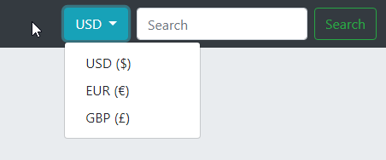
Lab #3: Testing the currency switcher
Using the Cypress window, double click on the file labs/3-check-currency-switcher.spec.js
Then write a new test that checks that:
The currency can be switched to EUR or GBP by using the dropdown in the nav bar
Changing the currency updates all prices and currency symbols

Slide 25
Custom commands
Instead of repeating common assertions/selectors, it is possible to define custom commands defined in cypress/support/commands.js
Cypress.Commands.add("login", (email, password) => {
cy.visit('/login');
cy.get('.login').type(email);
cy.get('.password').type(password);
cy.get('button[type="submit"]').click();
});
This command would be used like this:
cy.login("test@email.com","pa$$w0rd");

Slide 26
DEMO #5: Custom command
Let’s simplify our code with a custom command

Slide 27
Lab #4: Creating a custom command
Using the Cypress window, double click on the file labs/4-custom-command-for-titles.spec.js
Then write a custom command that validates the page title, font size, font weight, in one place
Then use that command in all three tests that check the current page title (home page / cart page / checkout page)

Slide 28
Lab #5: Testing the cart features
Using the Cypress window, double click on the file labs/5-cart-features.spec.js
All instructions for the tests to write are added as TODOs in that file
Implement all tests described in that file, and even more if you feel like it

Slide 29
Mocking server responses
Very often we don’t have multiple back-ends or databases to test different scenarios. Sometimes we don’t even have one at all!
Cypress allows us to fix that by mocking server responses:
cy.intercept('/rates', {EUR: 1.5, GBP: 2})
URL to mock
Mocked response

Slide 30
Mocking server responses using fixture files
Our mock data does not have to be hard-coded in Javascript though
Cypress allows us to return the contents of a file too:
cy.intercept('/plates', {fixture: 'plates.json'});
Name of any file located in cypress/fixtures

Slide 31
Cypress aliases
Cypress allows us to defines aliases any selected element:
beforeEach(function () {
cy.get('button').as('myButton')
});
it('has access to text', function () {
this.myButton // is now available
});
Declaration of the alias
Note that the following syntax only works with regular functions, not arrow functions

Slide 32
Cypress aliases and wait
Aliases can also be used as a means to wait for a request to complete:
beforeEach(() => {
cy.intercept('/rates', {EUR: 1.5, GBP: 2}).as('rates');
cy.visit('/');
cy.wait('@rates');
});
Wait for that data request to complete (optional)

Slide 33
DEMO #6: Mocking data
Let’s use mocked data so that exchange rates are always the same in our tests

Slide 34
Lab #6: Testing the checkout features
Using the Cypress window, double click on the file labs/6-checkout-features.spec.js
All instructions for the tests to write are added as TODOs in that file
Implement all tests described in that file

Slide 35
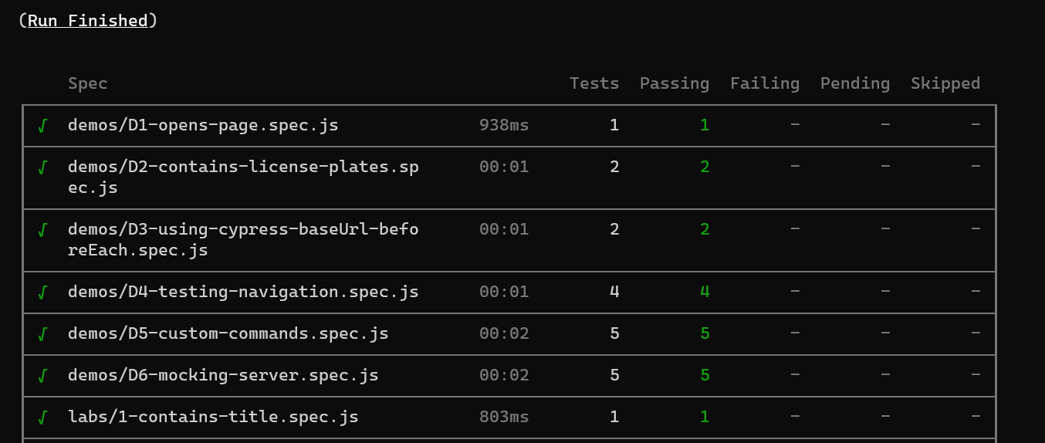
Cypress and Continuous Integration
All tests can be run in a windowless mode using the command:
npx cypress run

Slide 36
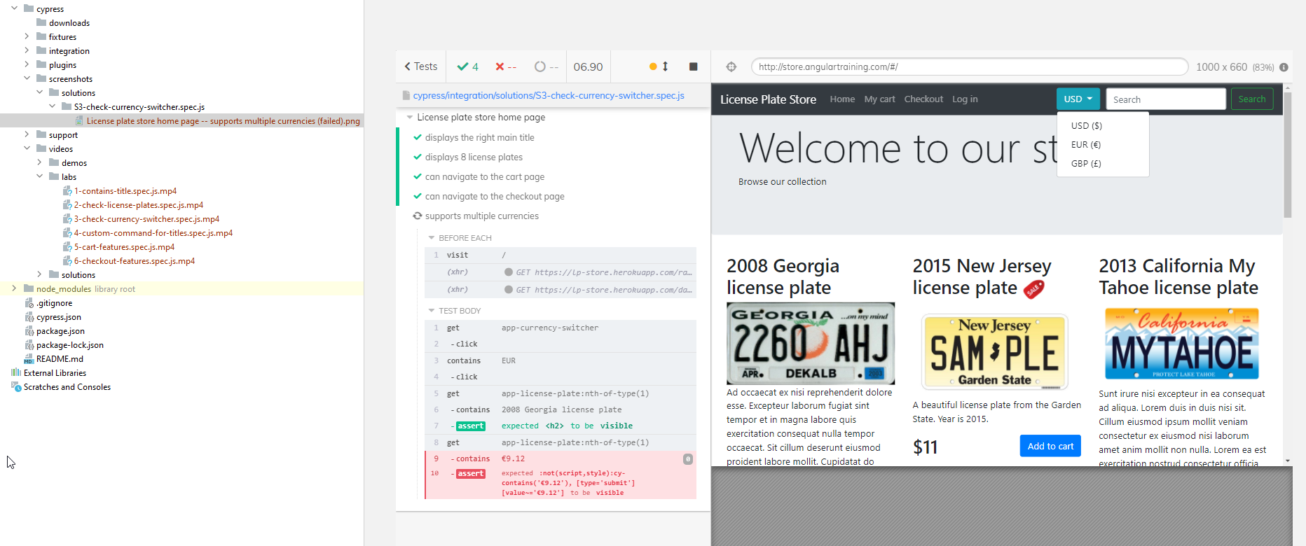
Cypress and Continuous Integration
Test runs produce video recordings of all tests as well as screenshots of test failures, making it easier to debug after the fact:

Slide 37
DEMO #7: npx cypress run
Let’s check the output of a windowless test run

Slide 38
Lab #7: Debugging a test using videos and screenshots
A test is failing in labs/7-debugging-checkout-features.spec.js
Run npx cypress run and using the screenshot or video output, try to fix the test

Slide 39
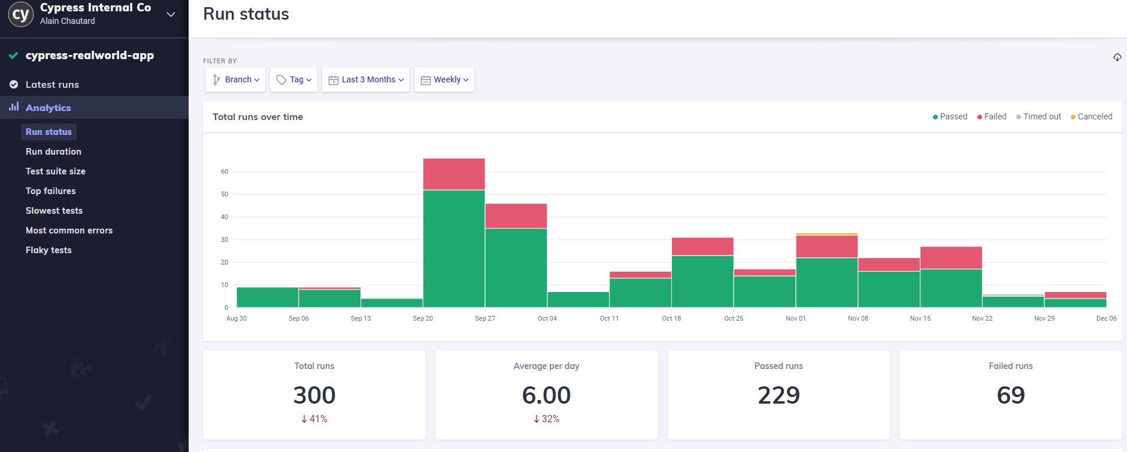
Cypress Dashboard
Test recordings can be uploaded automatically to an online dashboard :

Slide 40
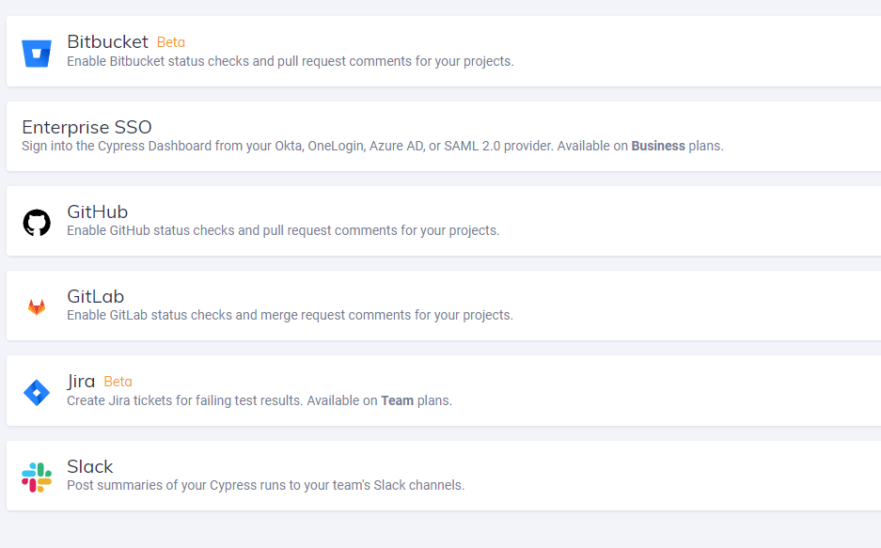
Cypress Dashboard
Multiple integrations are available with the online dashboard :

Slide 41
DEMO #8: Dashboard
Let’s check the stats of some test runs
Notes:
License plate store dashboard: https://dashboard.cypress.io/projects/jvwuev/runs/1/specs
Sample dashboard: https://dashboard.cypress.io/projects/7s5okt/runs?branches=%5B%5D&committers=%5B%5D&flaky=%5B%5D&page=1&status=%5B%5D&tags=%5B%5D&timeRange=%7B%22startDate%22%3A%221970-01-01%22%2C%22endDate%22%3A%222038-01-19%22%7D

Slide 42
Lab #8: Setting up the Cypress Dashboard
Go to https://dashboard.cypress.io/ and set-up your free account
Create a new project using the project creation wizard
You’ll get a projectId and a key used to record test runs
Run npx cypress run --record and check the progress of your test run in the online dashboard

Slide 43
Cypress: Other features to explore
Component testing with React or Vue
Authentication
Debugging
Clock

Slide 44





Thanks for your attention
Use coupon code INDYCODE23 to get any 20% OFF any course or certification exam at:
https://www.angulartraining.com
Link to these slides:
http://bit.ly/ac-cypress
https://blog.angulartraining.com
Subscribe to my FREE Angular newsletter

Slide 45
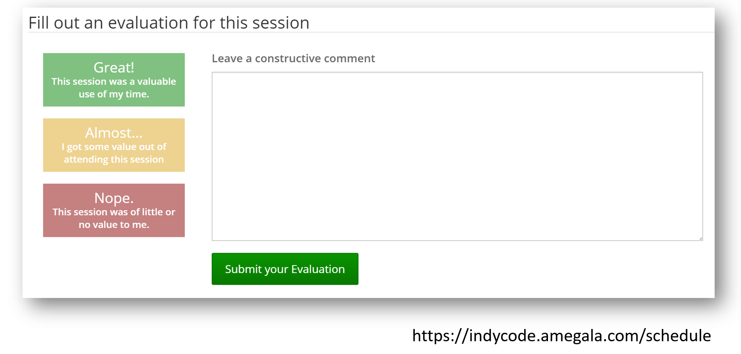
Thanks for your attention
Use coupon code INDYCODE23 to get any 20% OFF any course or certification exam at:
https://www.angulartraining.com
Link to these slides:
http://bit.ly/ac-cypress
https://blog.angulartraining.com
Subscribe to my FREE Angular newsletter

